Slide 1
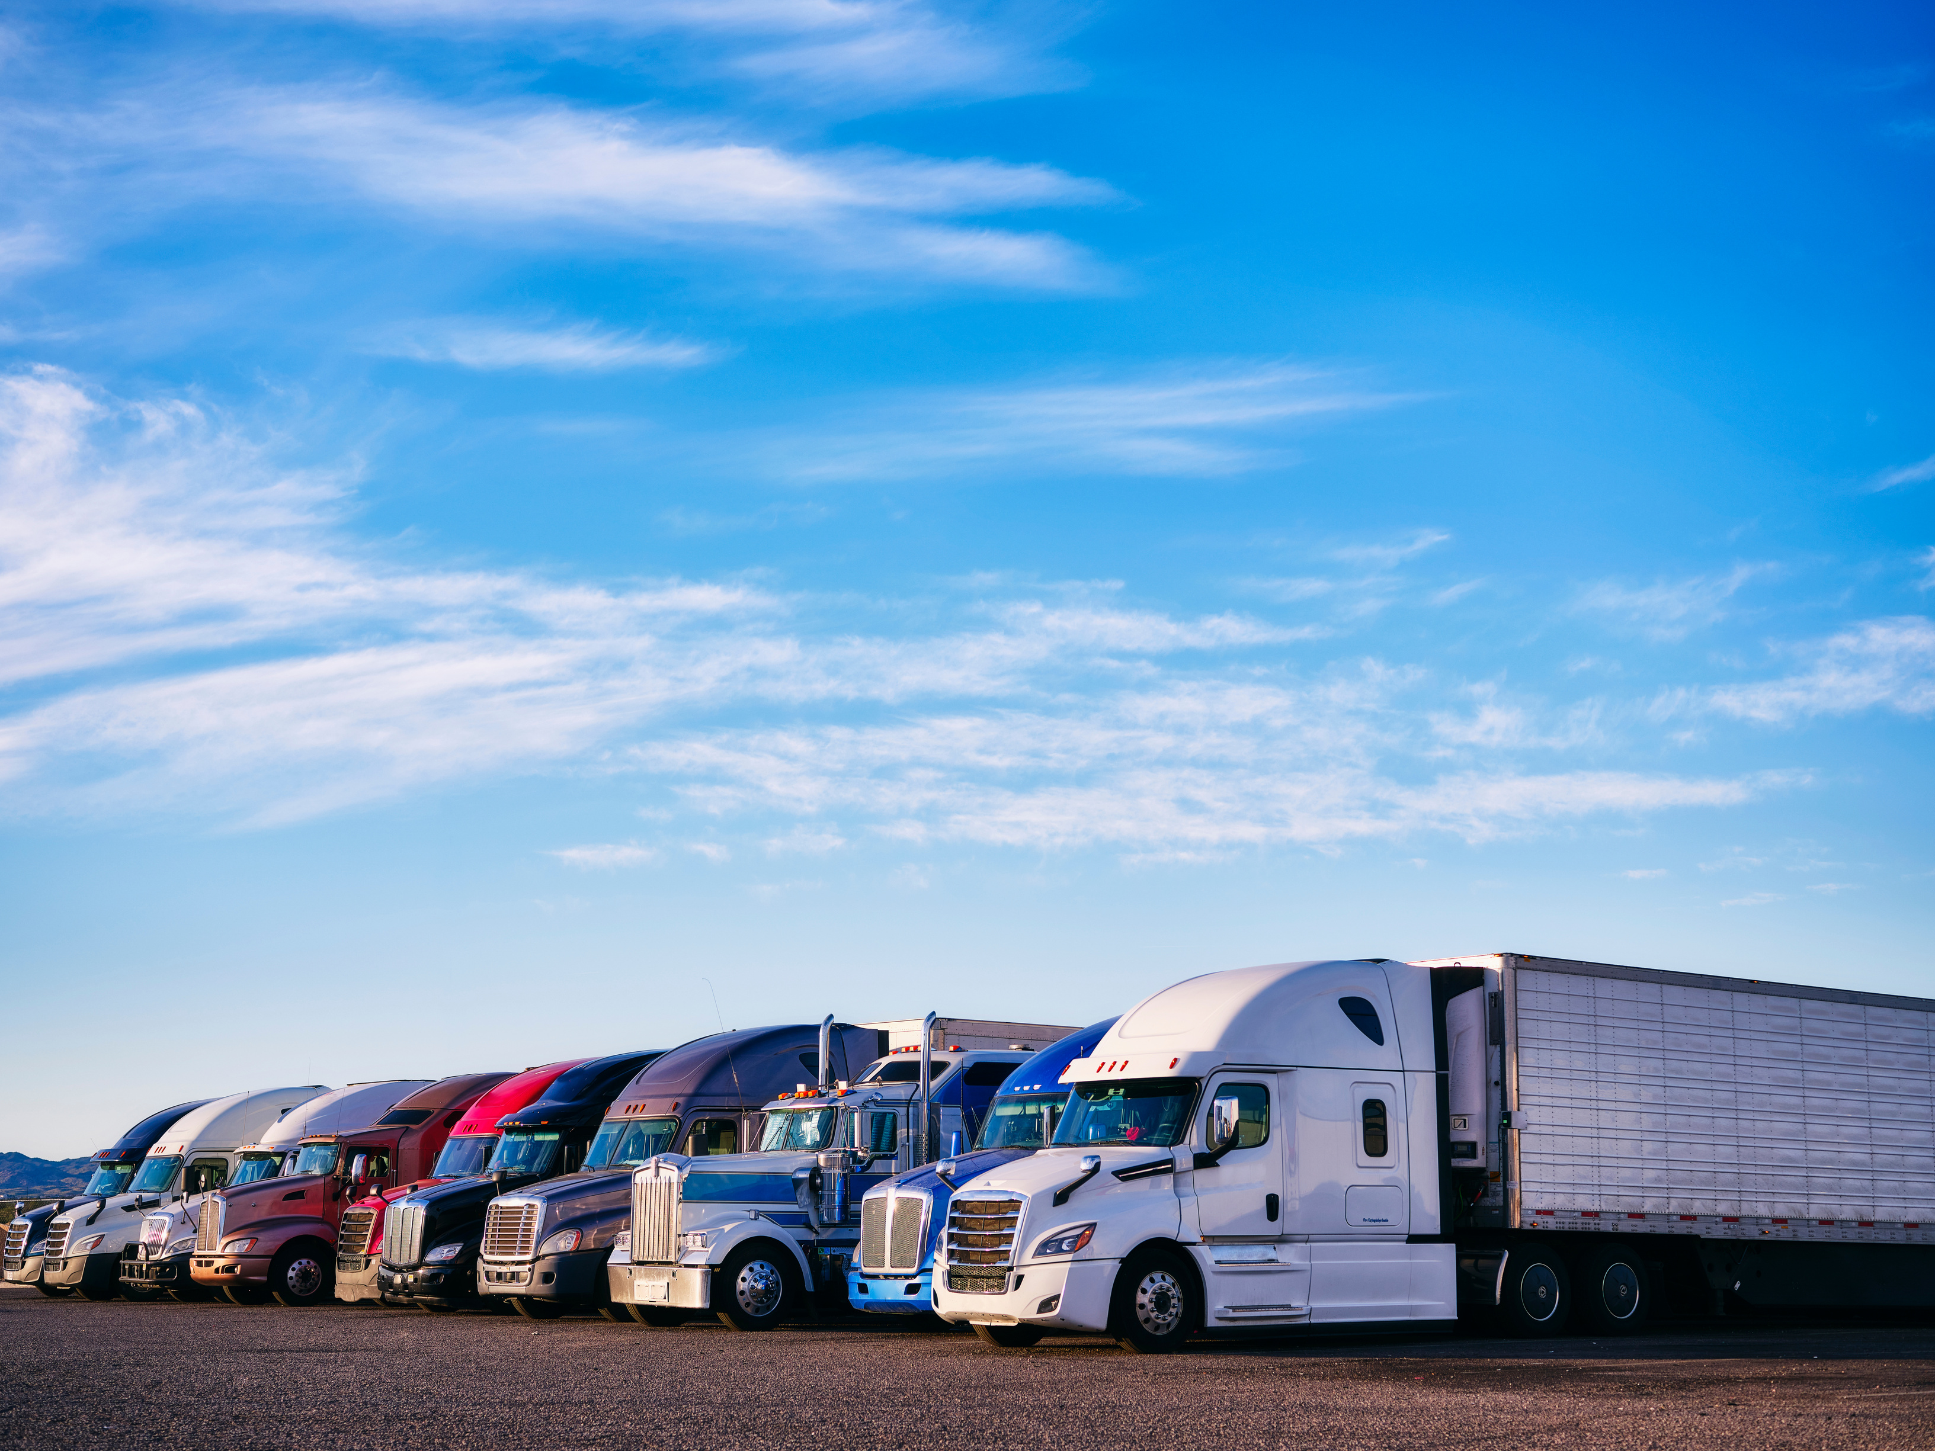

How Autonomous Trucking Will Deliver the Future!
Economic Club of Florida
August 27, 2024

Slide 2
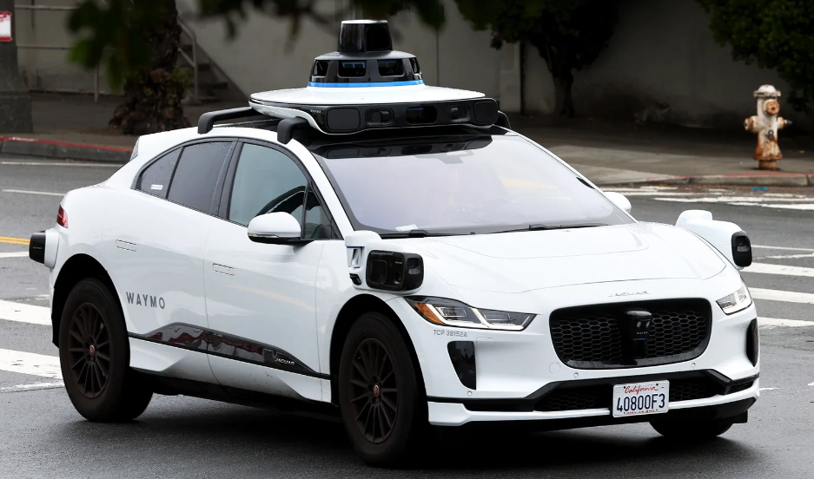

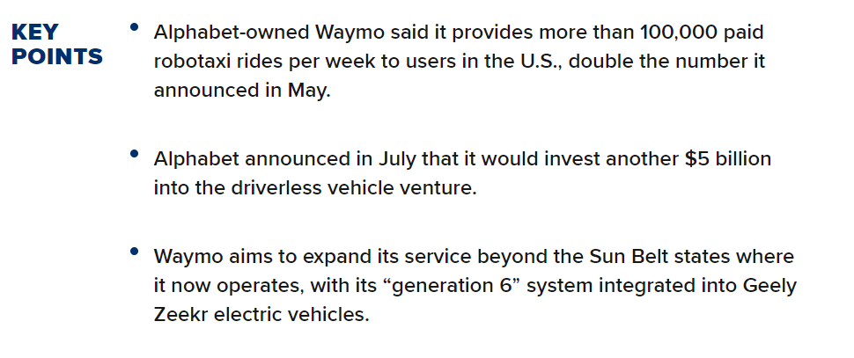
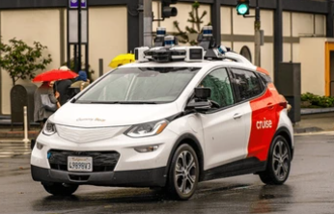
Robo Taxis – Passenger Vehicles:
Source: Yahoo News

Slide 3
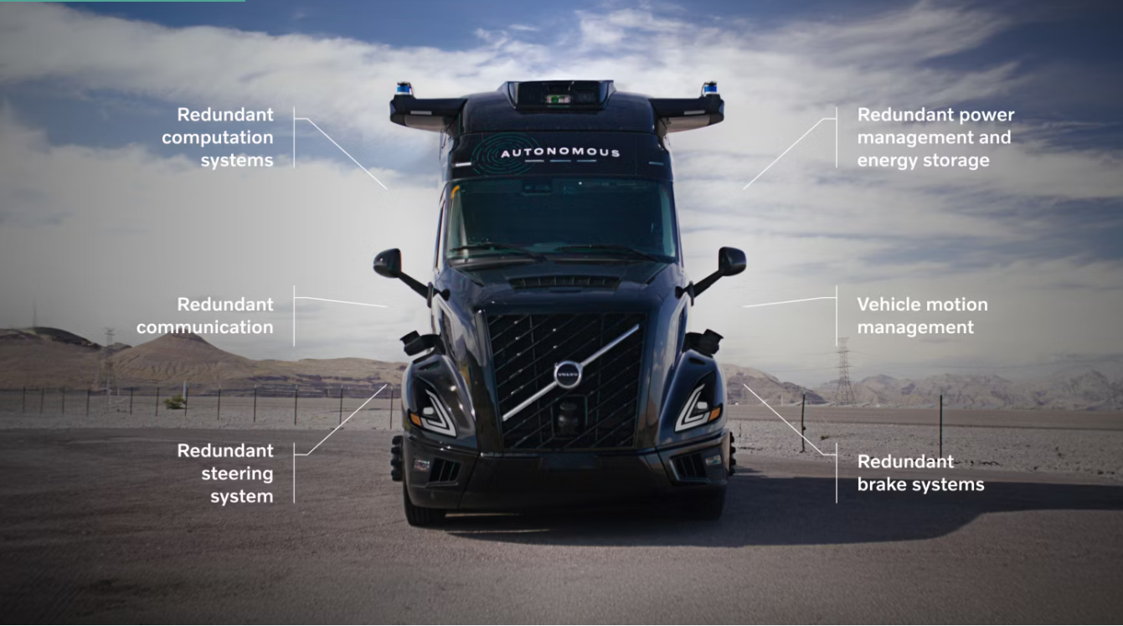
What is an Autonomous Truck?
Source: Volvo Web site

Slide 4
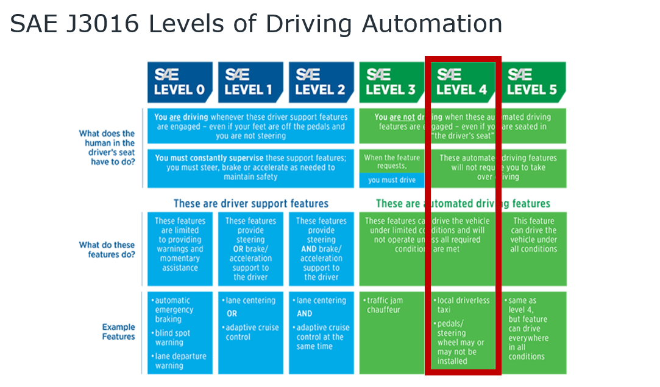

Slide 5
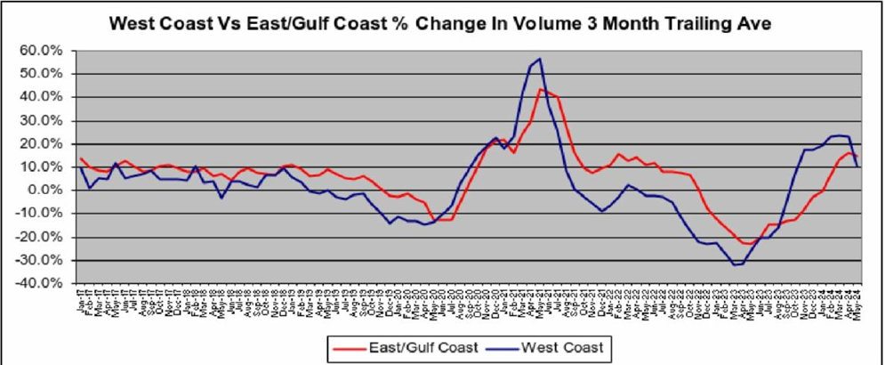
U.S. Seaport Volumes
Source: The McCown Report

Slide 6
Logistic Companies Focus and Path
The Outer Circle “Inside the four walls”:
Robotics in warehouse and
sorting applications
The Middle Ring “On Property”
applications of AV:
Outside the four walls, but still on
private property
To improve capacity, safety, and cost
Yard Operations, Agriculture, Parking Lots,
Ports, Airports are “On Property”
The Bullseye:
Deploy AV trucks at scale in networks
6

Slide 7
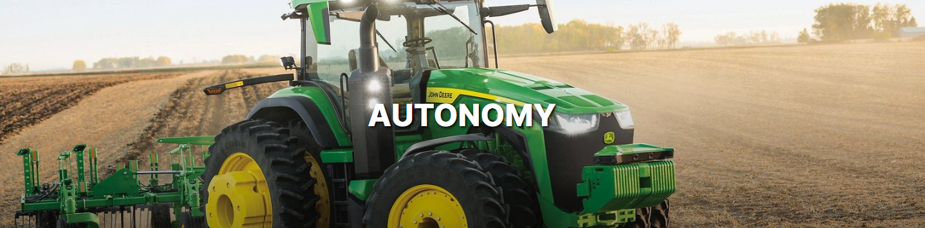
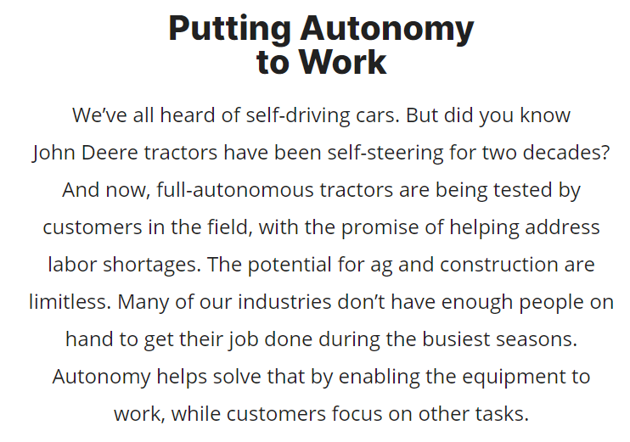
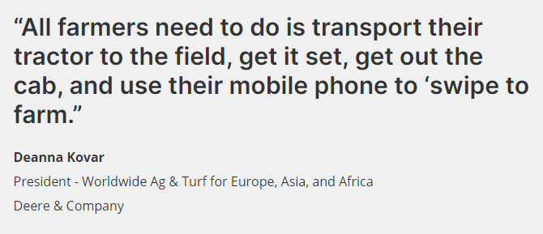
Autonomous On Property Vehicles
7

Slide 8
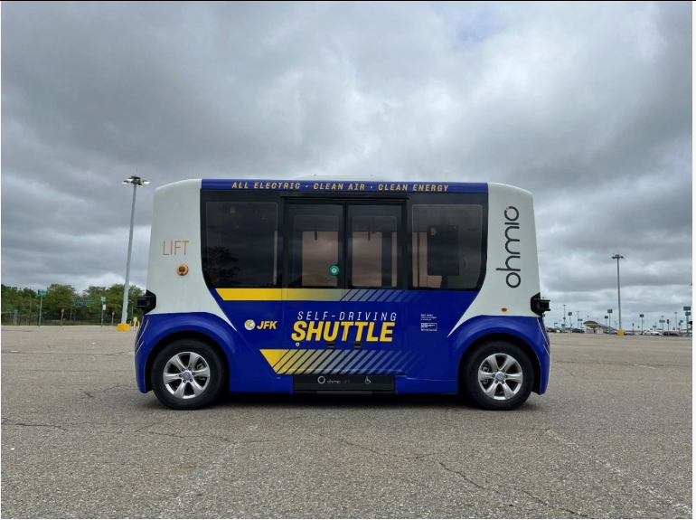
On Property Examples
Self-Driving Shuttles Coming to New York’s JFK Airport – July 10, 2024
Two autonomous buses will transport passengers starting in mid-July.
The shuttles will operate at JFK’s Parking Lot 9 – which is connected to AirTrain’s Lefferts Boulevard and Howard Beach Stations – and use the same stops and same route as the conventional human-driven bus which normally operates there. Each can carry eight seated passengers.
While initially the new shuttles will drive around the lot one at a time, ultimately the hope is that more will join the pilot to create platoons, which will result in shorter wait times for passengers.
8

Slide 9
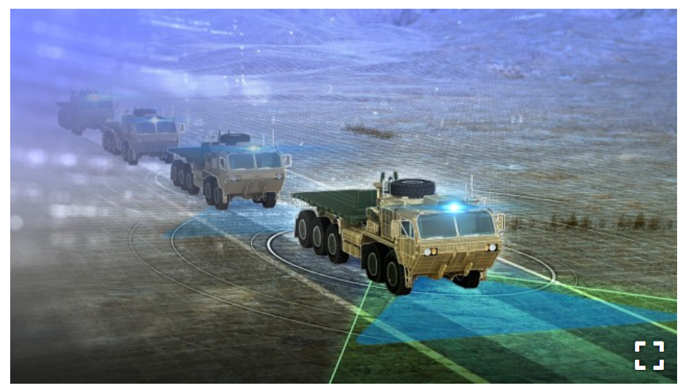

DETROIT ARSENAL, Mich. — The Army earlier this week announced three Other Transaction Authority agreements awarded to Robotics Research Autonomous Industries, Neya Systems, and Carnegie Robotics respectively, valued at $14.8 million to provide four prototypes from each vendor for the Autonomous Tactical Vehicle System, or ATV-S, program.
ATV-S’ desired characteristics include:
Increasing material throughput by eliminating the need for operator work/rest cycles.
Removing Soldiers from the vehicles.
Providing commanders flexibility of autonomous modes to suit mission requirements.
Providing safe, reliable, and cyber-secure operation.

Slide 10

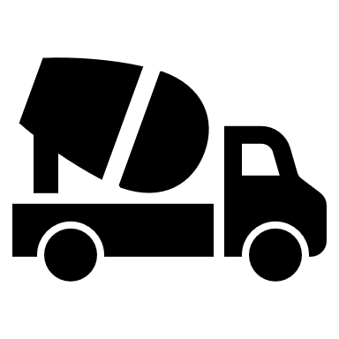

Three Big Sources of Truck Freight
Household Consumption/Retail
Construction: Home & Non-residential
Factory & Industrial
We are seeing green shoots in some areas for the first time in over 2 years. Still too early to call a recovery, but it is trending better.

Slide 11
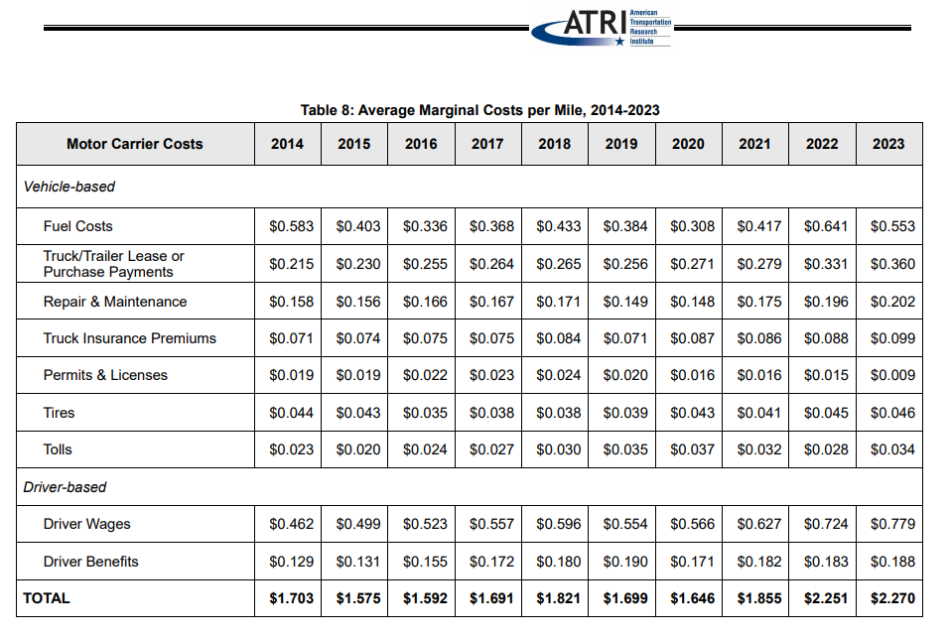



38%

Slide 12
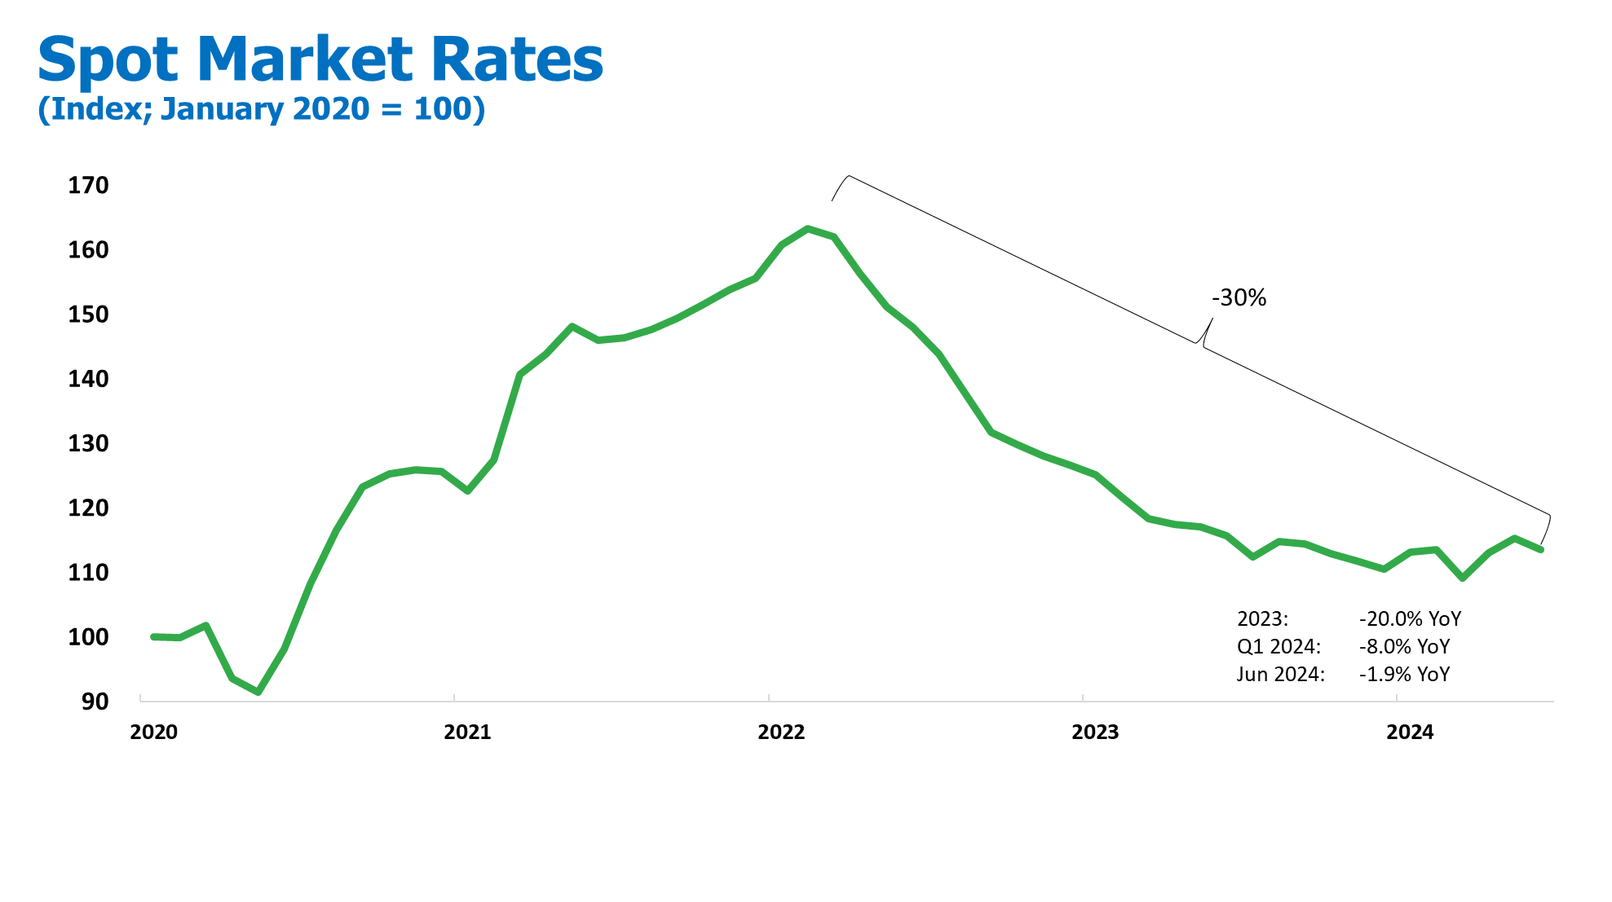

Slide 13
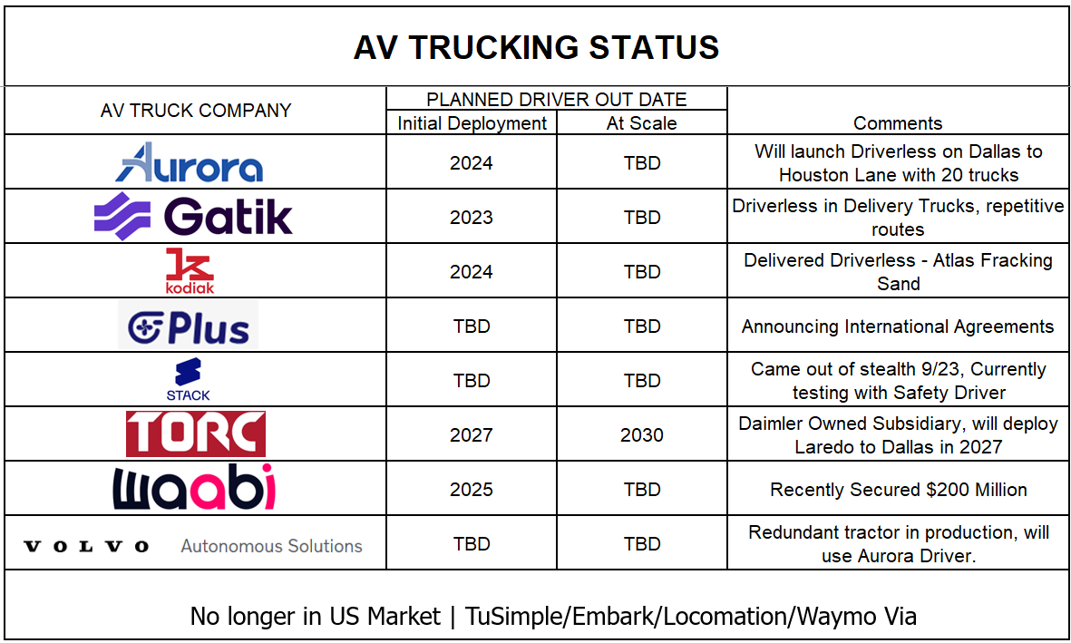

Slide 14
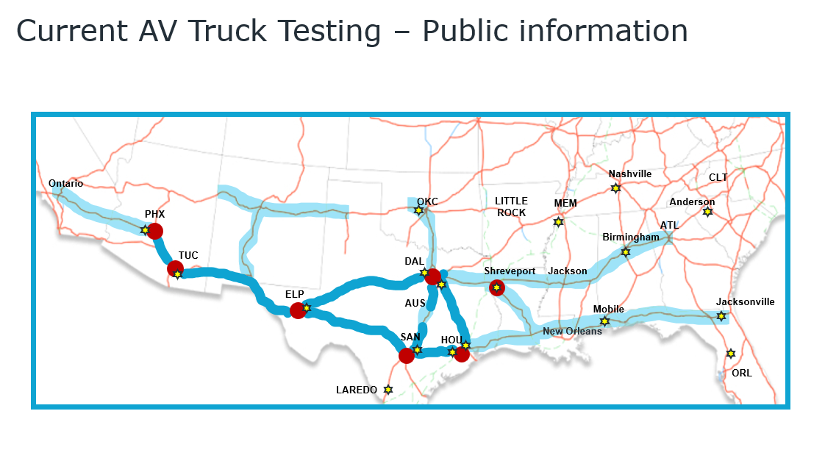

Slide 15
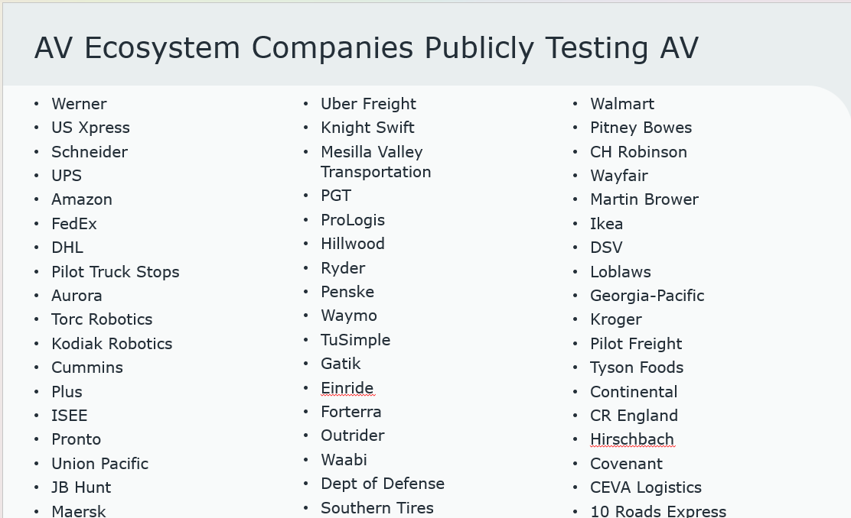

Slide 16
SAFETY
Learning from Human Drivers’ Collisions between Dallas and Houston
While NHTSA’s crash taxonomy helps us anticipate what could happen on the road and prepare accordingly, it is also essential to understand what has happened on the road – providing the ability to learn from past collisions by human drivers and help prevent them in the future.
As part of our validation of the Aurora Driver’s expected performance at commercial launch, we examined fatal collisions involving human-driven Class 8 trucks on our Dallas-Houston launch route between 2018-2022. Using data available about these crashes, our team recreated the collisions in simulation to understand how the Aurora Driver would have acted in comparable circumstances. Based on our analysis, in the 29 instances in which the Aurora Driver could have been operating the initiating vehicle, the combination of its powerful sensors, attentive driving, and quick decision-making would have prevented the collisions.
Said simply, if the Aurora Driver had been in control, none of these fatal collisions would have occurred.

Slide 17






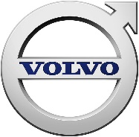












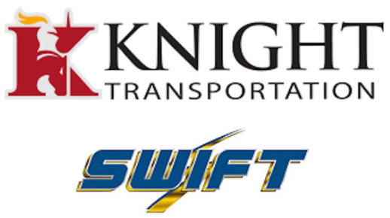











Current Manual Truck EcoSystem
Truck EcoSystem
OEM’s
Autonomous
Trucks
Fleets &
Carriers
Freight
Brokers
Customers
Tier 1’s
17

Slide 18
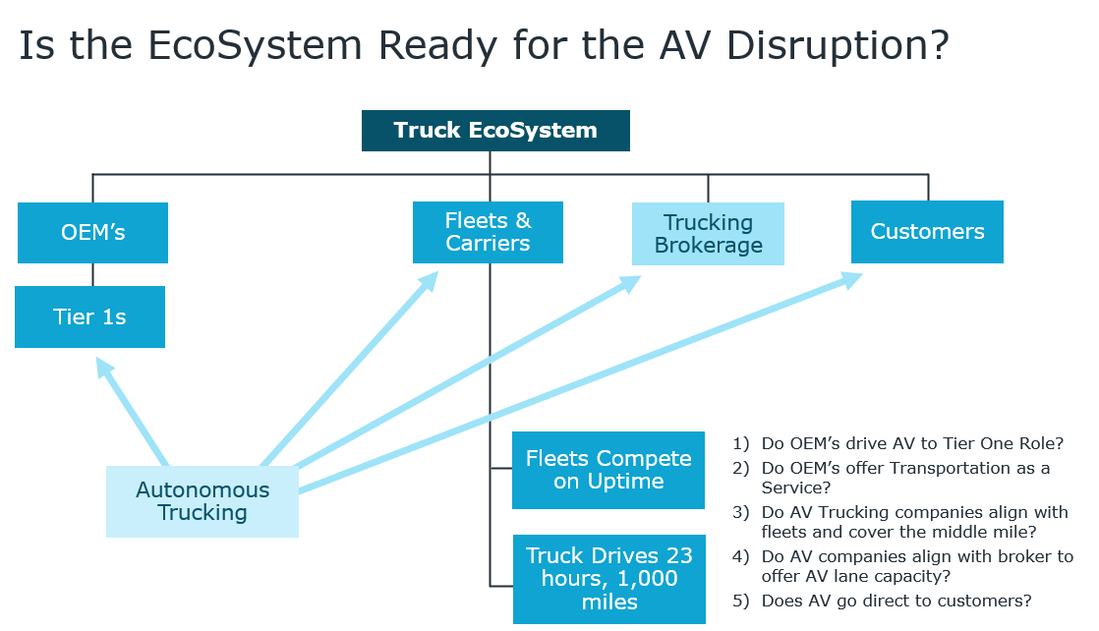

Slide 19
Autonomous Trucking Will Deliver the Future!
AV Trucking will be part of our future Supply Chain. The questions are Who, When, and Where?
It is no longer an “If” question.
The State of Florida is uniquely positioned with the Ports, Rail, and I-75, I-95 and I-10 Corridors to Adopt, Integrate and Scale AV Trucking.

Slide 20
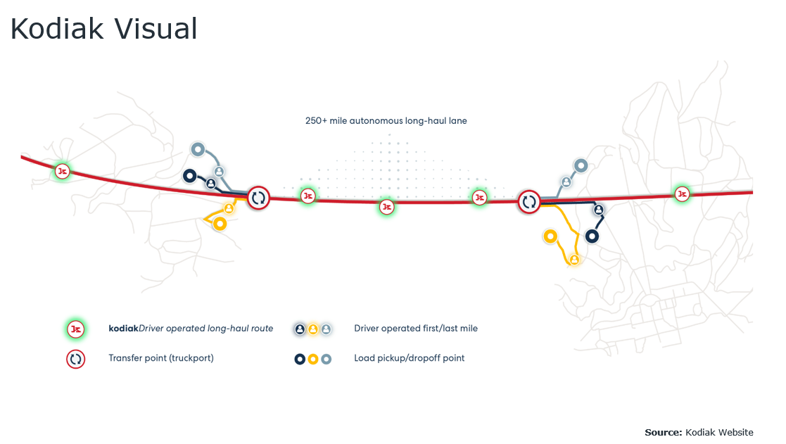

Slide 21




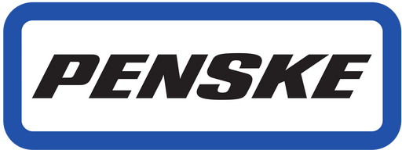

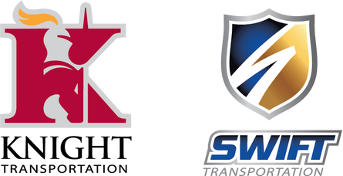





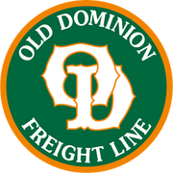
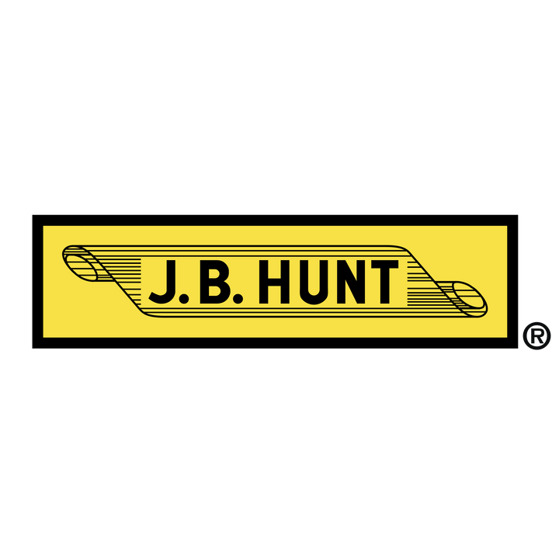
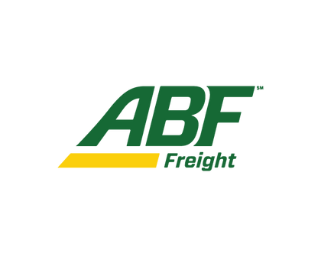







AV Truck Scaling
Terminal to Terminal
Truck Ports

Slide 22

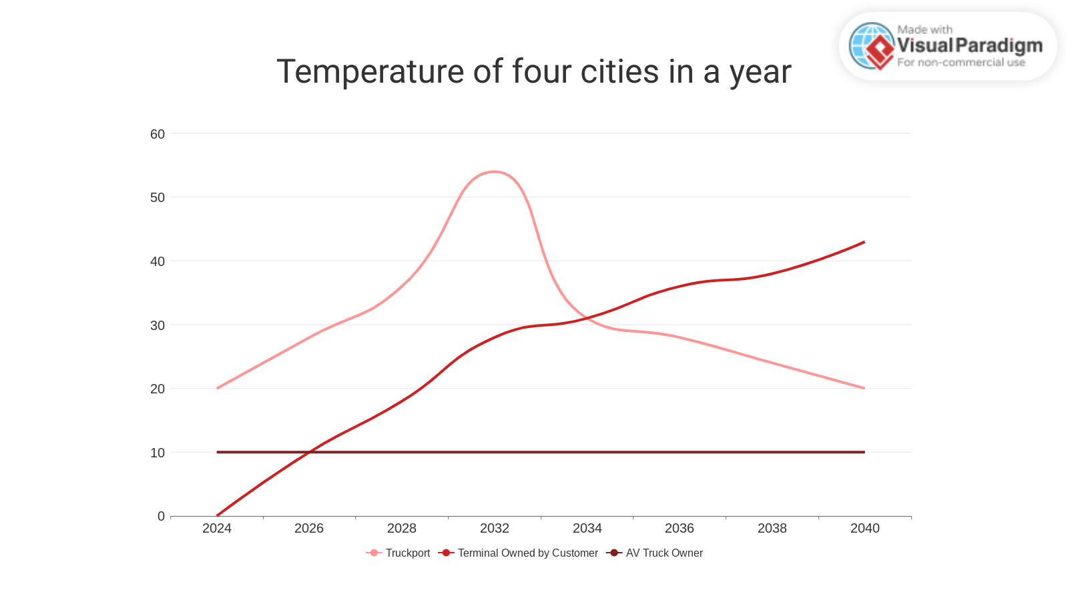
AV Truck Scaling
Where Do The Trucks Launch & Land?
Terminal Owned by Customer
Truckport
AV Truck Owner

Slide 23
